Slide 1
Study Design in Atherosclerosis
Maryam piri

Slide 2
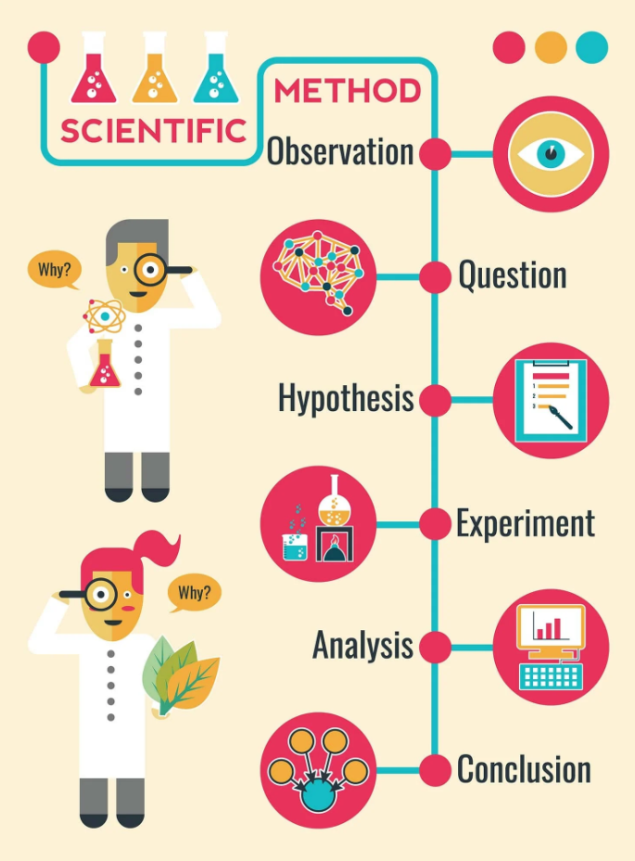
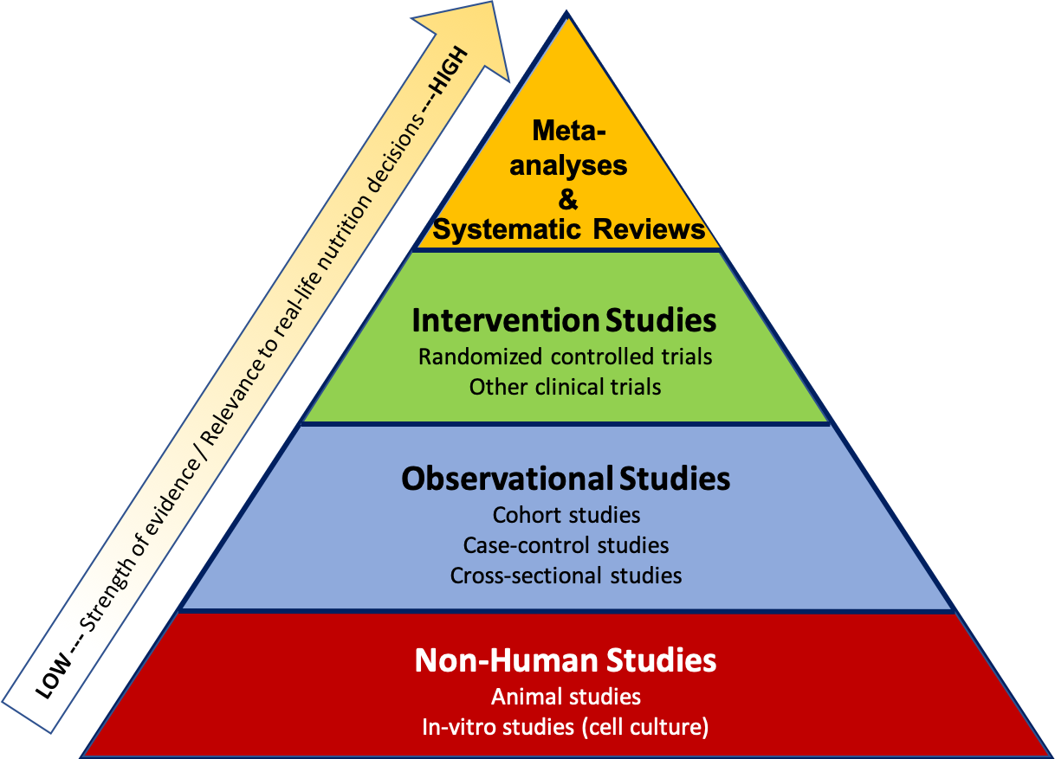
Classification of experiments and Scientific Method

Slide 3
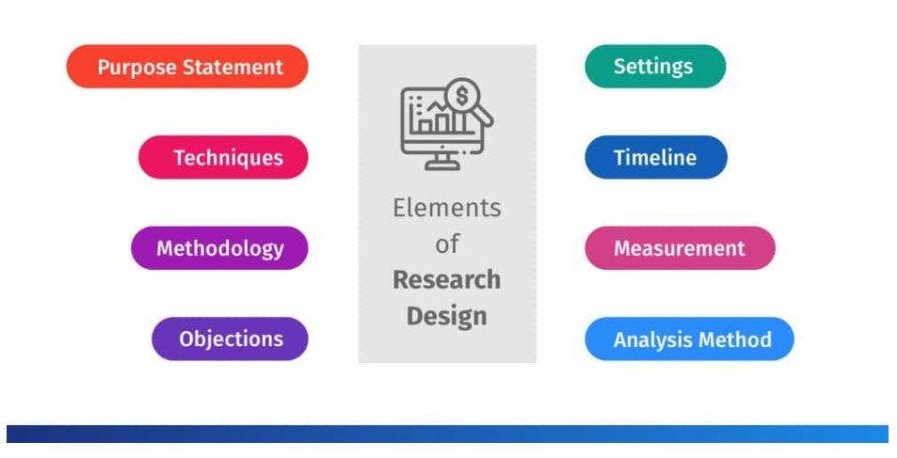

Study Design
Methodology
https://doi.org/10.1016/j.ymthe.2018.01.011

Slide 4
1. تحقیقات نشان داده که افراد با مشاغلی که شیفت شب دارند بیشتر در معرض خطر ابتلا به سکته قلبی قرار دارند. همچنین درمطالعات نشان‌داده که افراد با مشاغلی که شیفت کاری متغیر دارند، به دنبال برهم خوردن سیکل شبانه روزی‌شان میزان ملاتونین خونشان کاهش یافته.
مطالعه ای در دو بخش طراحی کنید که:
الف) به بررسی و مقایسه توانایی تجویز سیکلیک/پیش از خواب ملاتونین، درخنثی سازی اثر شیفت کاری، بر میزان ملاتونین خون را بپردازد.
ب) اثر نوع تجویز ملاتونین بر تشکیل و پایداری پلاک‌های آترواسکلروز را در نشان دهد.
هدف مطالعه
نوع مطالعه
مدل
مداخله (متغیر مستقل)
گروه‌بندی
متغیر (وابسته)
زمان‌بندی
روش سنجش متغیر
کنترل ابزار
نوع آنالیز آماری

Slide 5
Research models

Slide 6
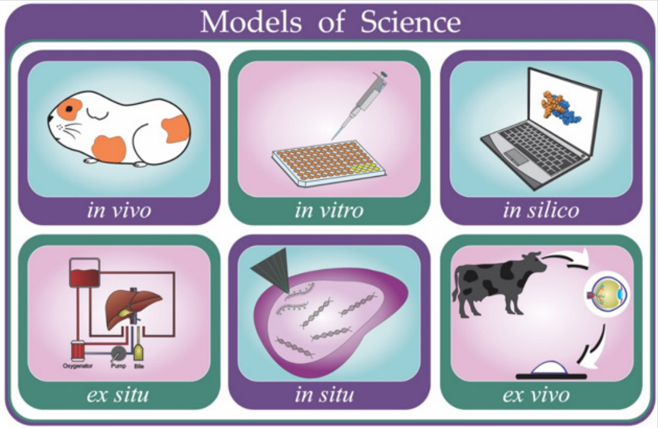
Research models in the biomedical sciences

Slide 7
In Silico
The first step is to define the research question or hypothesis to be tested. This could involve identifying potential therapeutic targets, investigating molecular mechanisms underlying the disease, or predicting the risk of developing atherosclerosis.
The next step is to select appropriate computational tools and models to address the research question. These may include databases, quantitative structure-activity relationships, pharmacophores, homology models, molecular dynamics simulations, machine learning, data mining, network analysis tools, and data analysis tools. The selection of appropriate tools and models will depend on the specific research question and the available data.
The next step is to validate the models and optimize the parameters. This involves testing the models against experimental data and adjusting the parameters to improve the accuracy of the predictions.
The next step is to apply them to the research question. This may involve simulating the effects of potential therapeutic interventions, predicting the risk of developing atherosclerosis, or investigating molecular mechanisms underlying the disease.
Finally, the results of the in silico study should be validated experimentally. This may involve testing the predictions in animal models or in vitro experiments.
In summary, designing an in silico study for atherosclerosis research involves defining the research question, selecting appropriate computational tools and models, validating and optimizing the models, applying them to the research question, and validating the results experimentally.

Slide 8
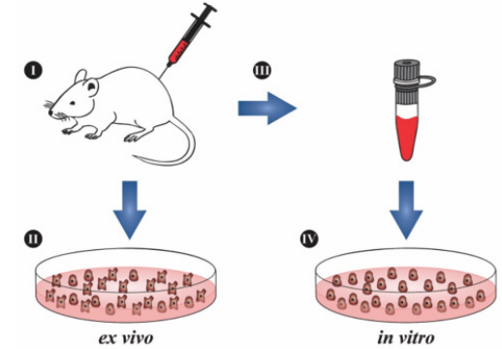
Ex vivo

Slide 9
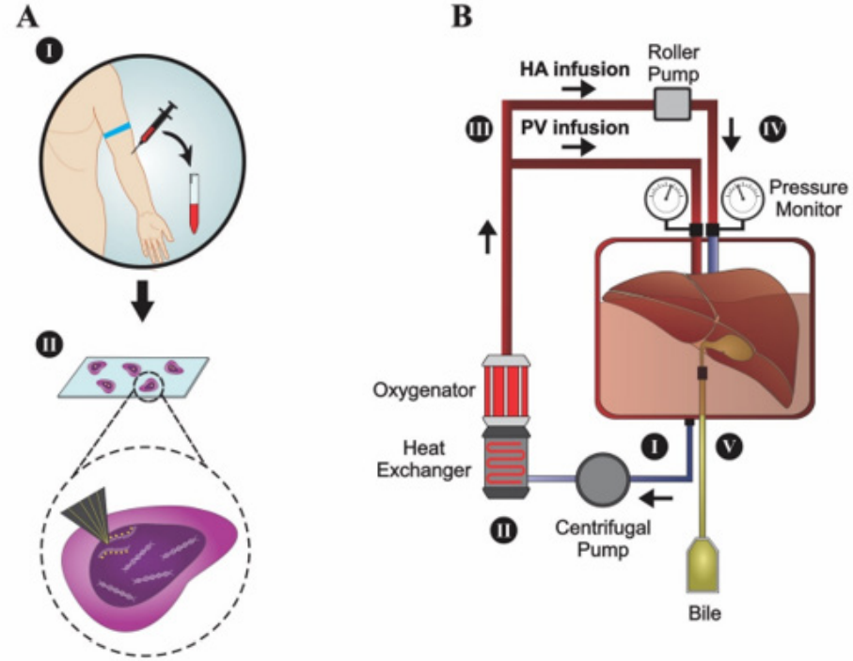
In situ and Ex situ models

Slide 10
In vitro

Slide 11
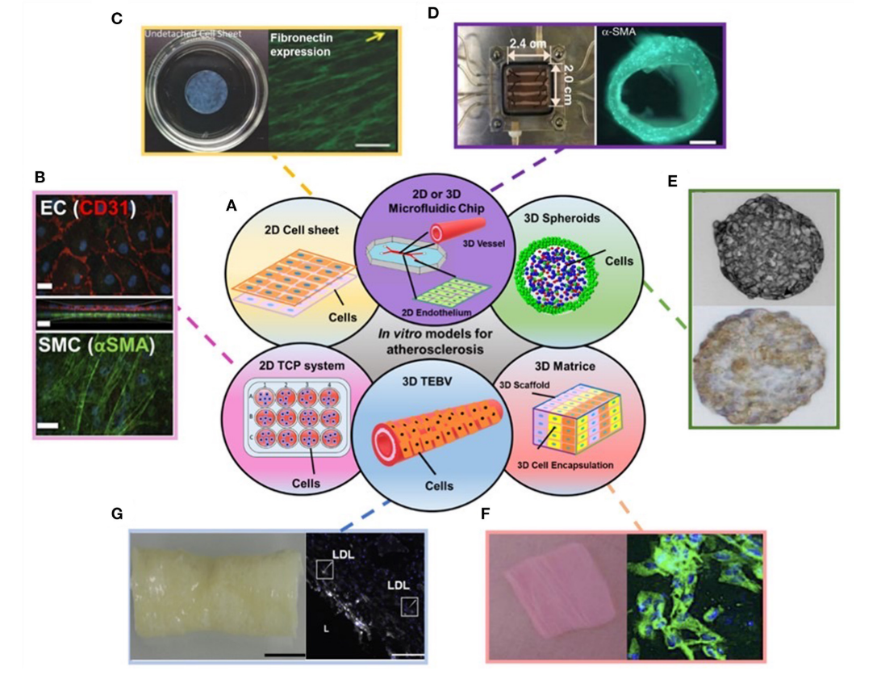
A schematic of in vitro models for atherosclerosis studies
(B) Endothelial cells (ECs) (top) and Smooth muscle cells (SMCs) (bottom) stained with EC and SMC phenotype markers in 2D transwell model. (C) 2D cell sheet (left) that expresses fibronectin (right). (D) 3D microfluidic vessel on a chip (left) made of green fluorescence protein-expressing human umbilical vein endothelial cells (right). (E) SMC spheroid (top) and EC/SMC spheroid (bottom). (F) 3D SMC laden hydrogel constructs (left) and stained with SMA-α (right, green). (G) 3D tissue-engineered blood vessels (left) and stained with monocytes and LDL (right).

Slide 12
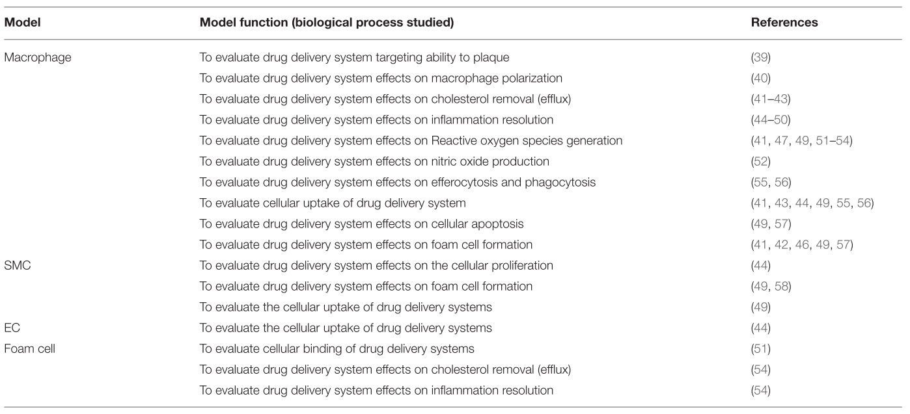
in vitro 2D single-cell culture
Summary of in vitro 2D single-cell culture model and its specific function for evaluating drug delivery system for atherosclerosis

Slide 13
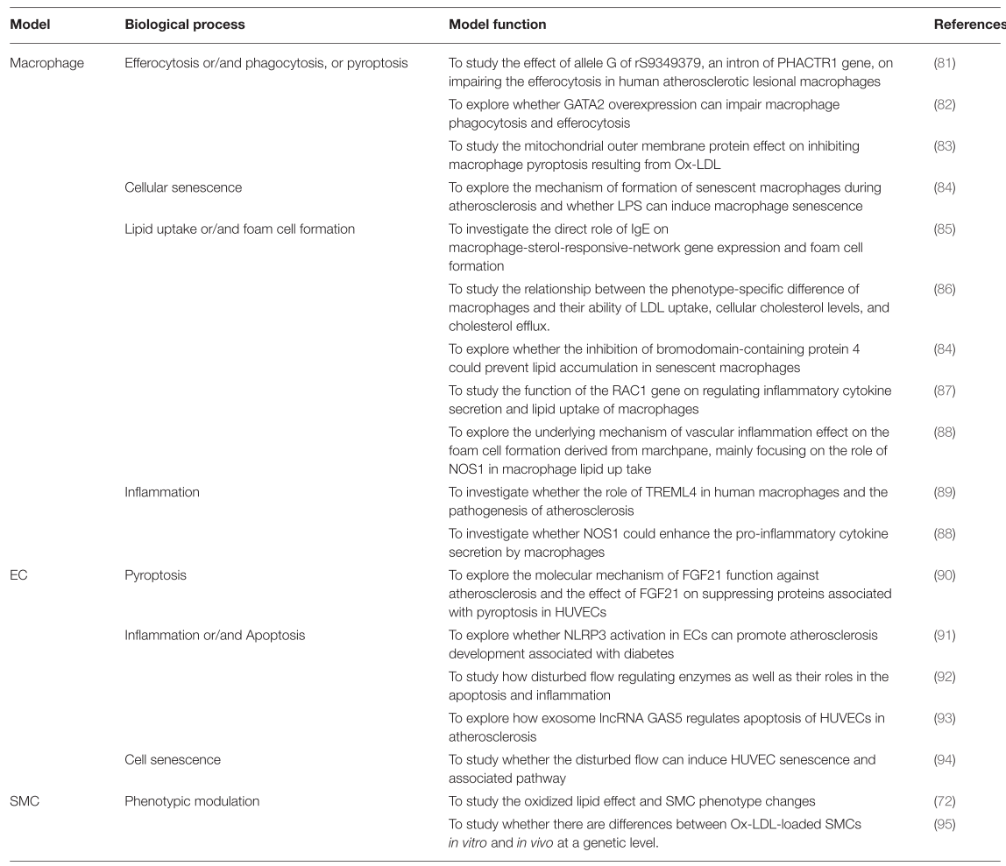

Slide 14
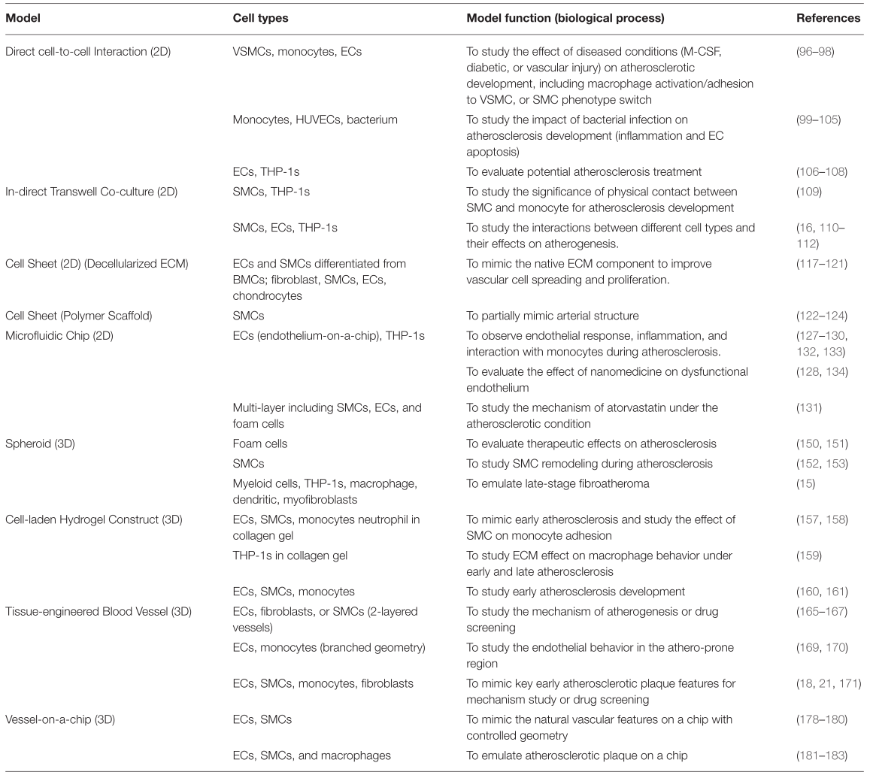
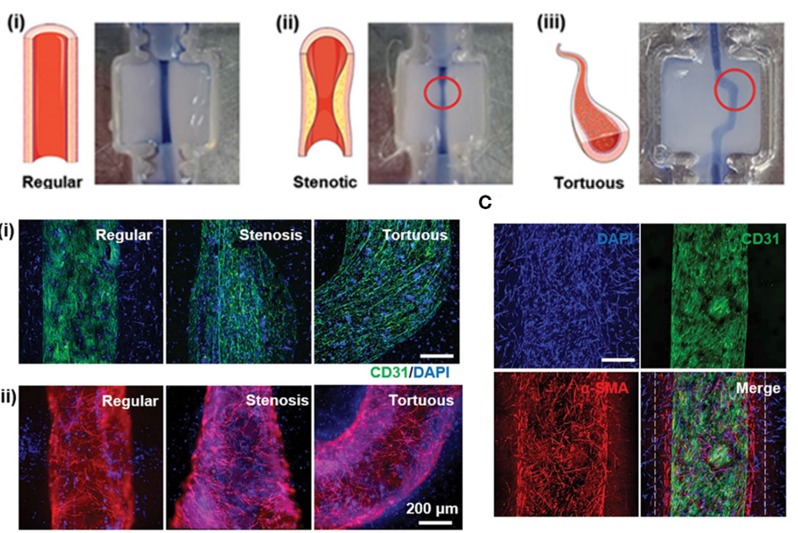
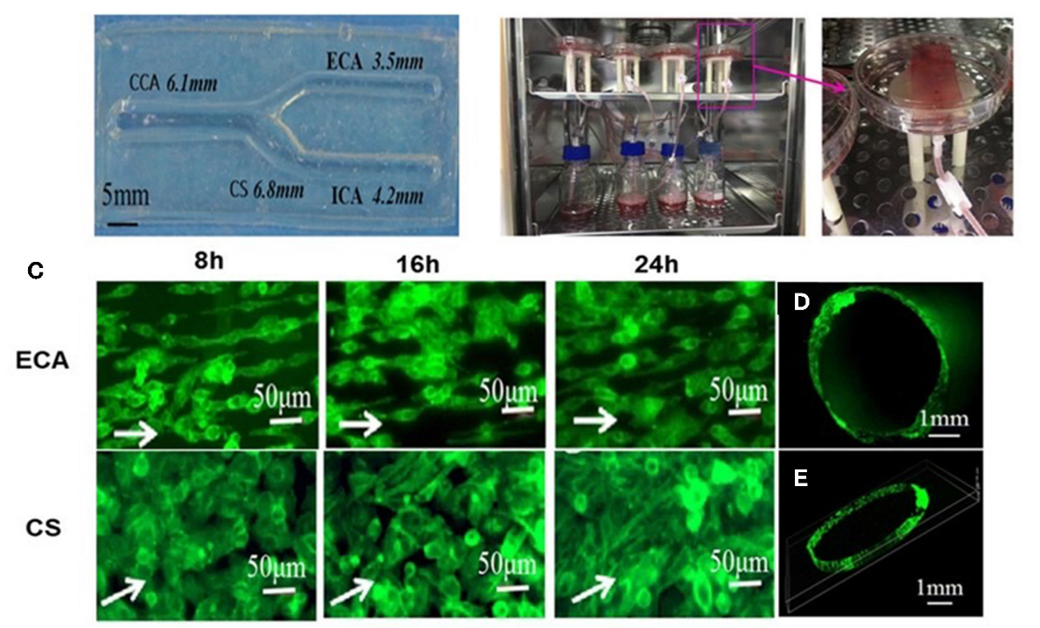

Slide 15
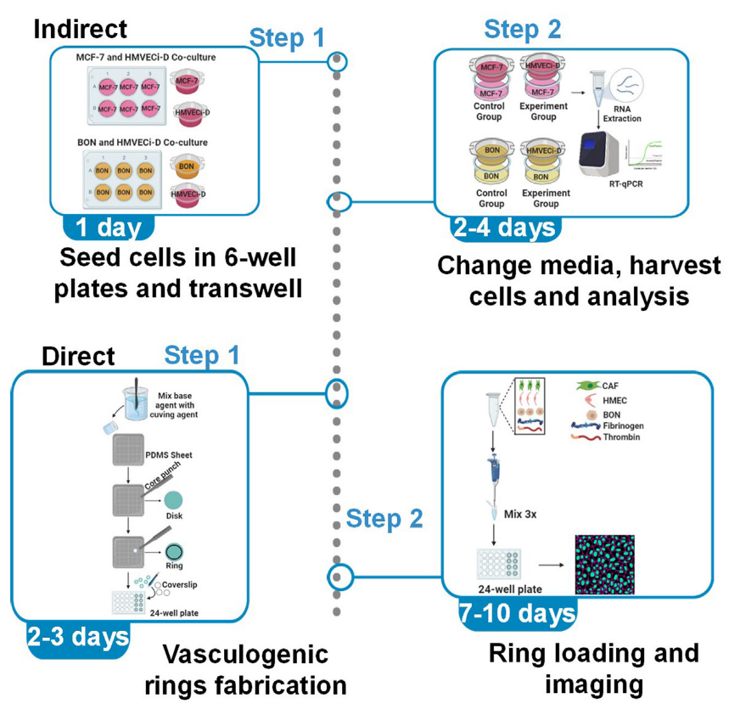
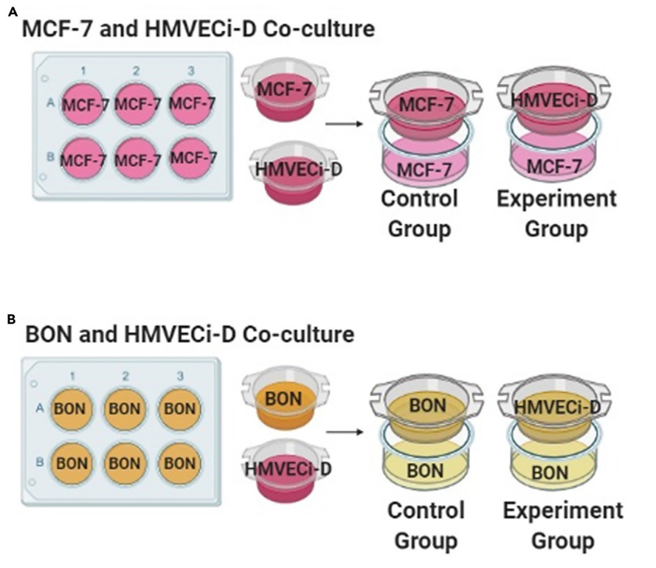

Slide 16
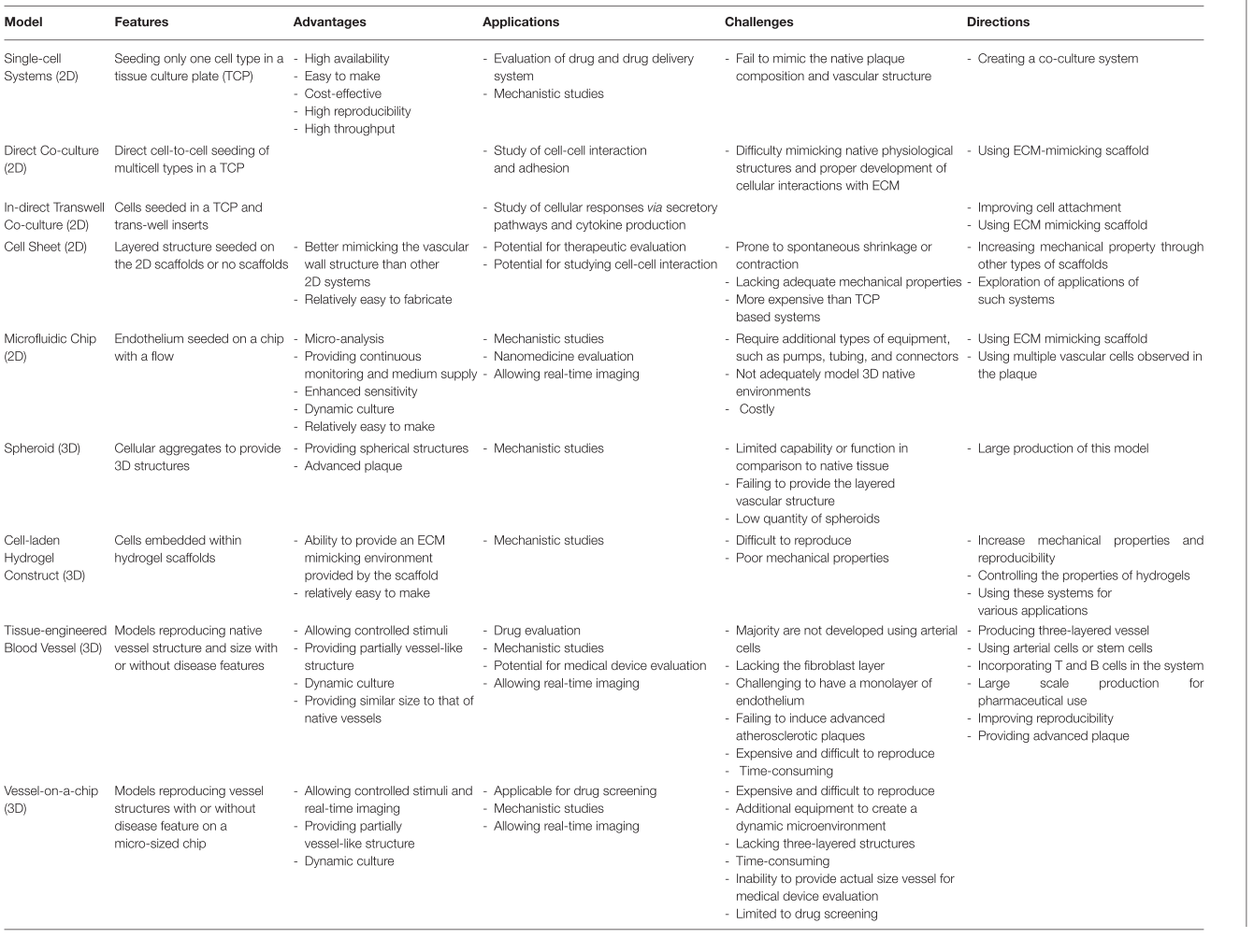

Slide 17
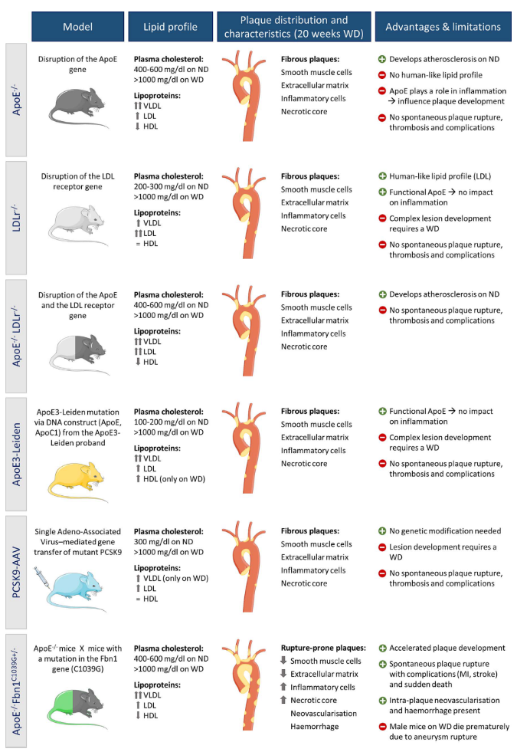
In vivo
Overview of current mouse models of atherosclerosis. This figure describes the different models with their total plasma cholesterol levels on normal (ND) and Western-type diet (WD), lipoprotein profile, plaque characteristics, advantages and limitations. The distribution of the plaques in the thoracic aorta and the complexity is shown for mice fed a WD for 20 weeks. The composition of the most complex lesions at that time point is displayed (usually found in the aortic root or brachiocephalic artery).

Slide 18
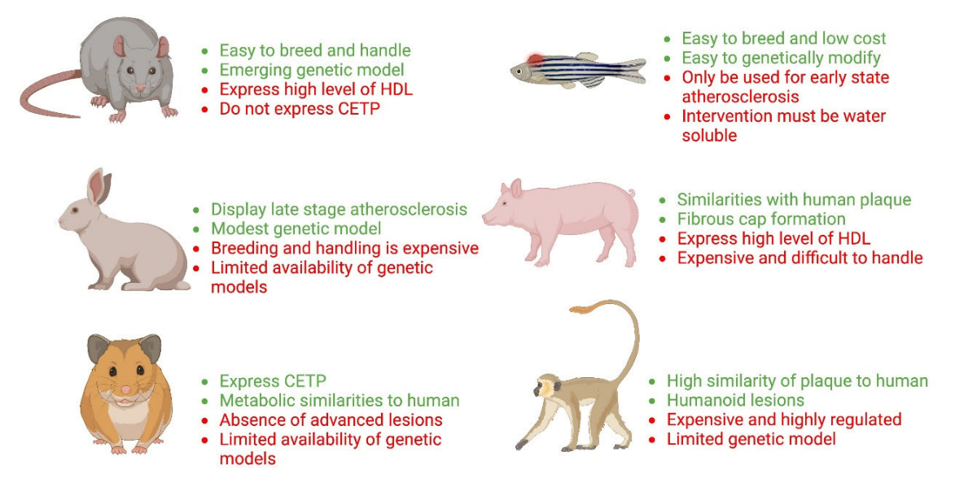
Non-mouse models of atherosclerosis

Slide 19
Variables

Slide 20
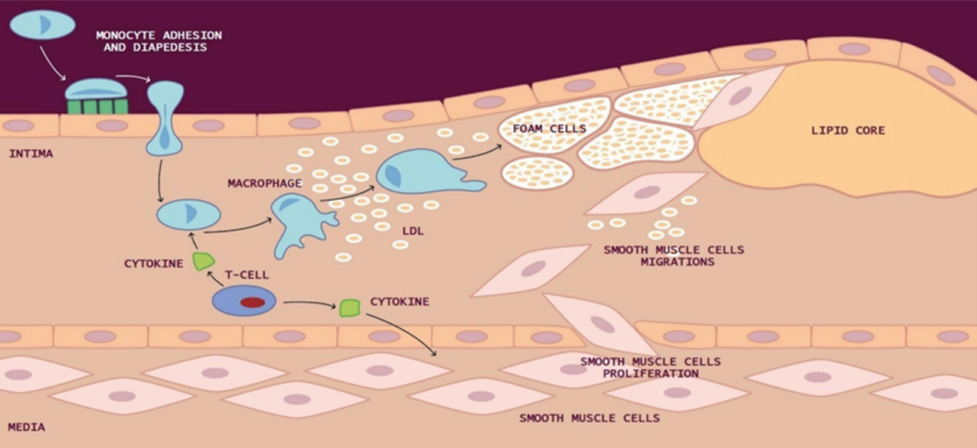
Biomarkers of atherosclerosis

Slide 21
Inflammation
Microparticles and exosomes
definition
Brown adipose tissue derived exosomes (ACADVL)
CRP
High sensitive C-reactive protein
IL-6 -> IL-1
NLRP3 inflammasome
Caspase
IL-1B and IL-6*
Exosome derived miRNA
Receptor on activated cells
NF-kB

Slide 22
Cells
T-cell
CD8
CD4
NK-cell
Invariant NKT
macrophages
M1 (pro-inflammatory)
Natural killer cell
Type II NKT
M2 (anti-inflammatory)

Slide 23
Cell Death
necrosis
HMGB1 (high mobility group box-1): a nuclear protein
FK-18 (full-length caspase 18)
apoptosis
Cleaved caspase-3 , 18, 8(binds to P-69)
autophagy
Beclin-1
Ferroptosis
Transferrin receptor
PS (phosphatidylserine): annexin V
DNA fragmentation
LC-3 (binds to p-69)
PTGS2 mRNA
MDA,4-HNE

Slide 24
Non-invasive Imaging
CT*
PET
MRI
PET/MRI
PET/CT

Slide 25
Measurement

Slide 26
Protein:
2d gel electrophoresis
Staining (silver, zinc,...)
Using metabolites
Labeling
Western blot
Chromatography
Gel filtration Chromatography (size exclusion)
Nucleic acids:
Electrophoresis (agarose, pulse filled, KFLP)
SNP
Dot slot blotting
Detection and quantification of RNA and DNA sequencing:
Northern blot
RNAse protection assay
Reverse transcription
Cloning and manipulation:
Plasmid and viral vector (PCR and RT-PCR)
SAGE
Gene silencing
Antibody-based techniques:
A) monoclonal
B) purification use:
As probe (iodinated, biotin, enzyme-linked, fluorescent, colloidal gold)
Identify quantitative antigens
Immune precipitation (radioimmunoassay, ELIZA, ELIZPOT)
C) flow cytometry (DNA content, apoptosis)

Slide 27
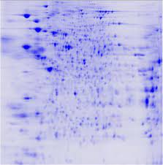
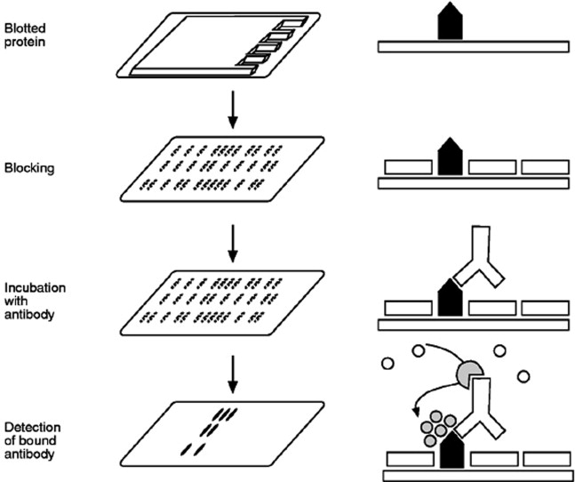
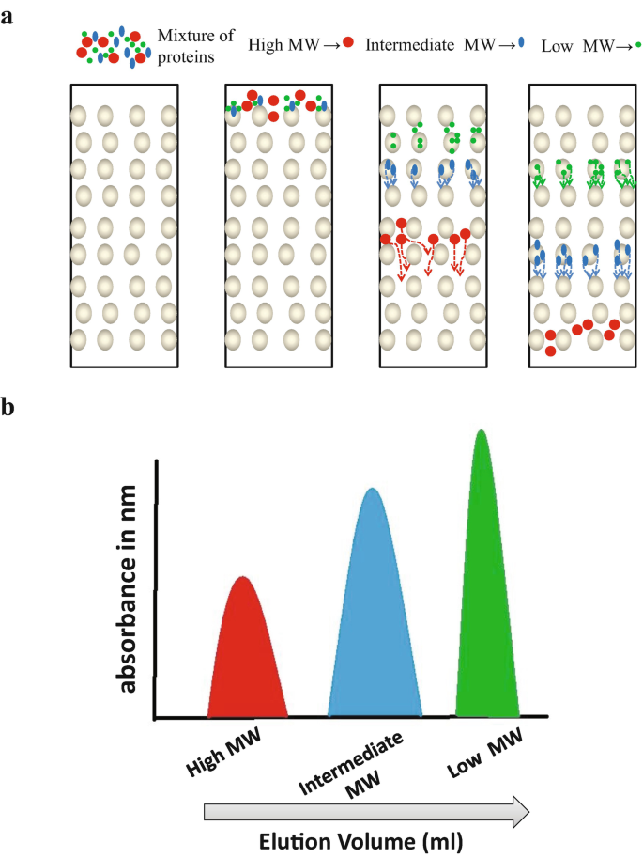
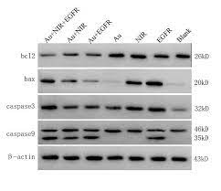
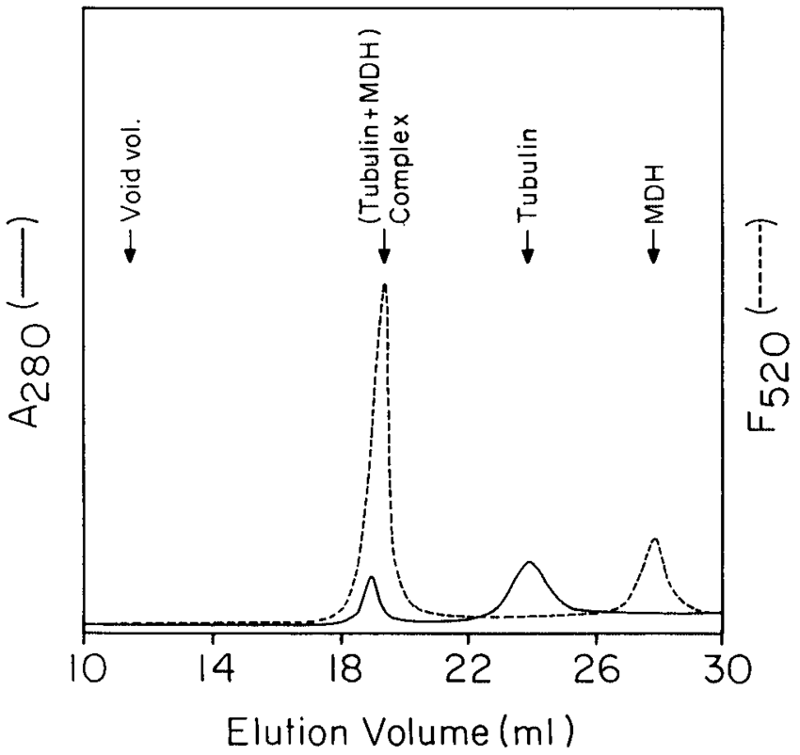
2d gel electrophoresis
Western blot
target protein complexes can be isolated by immunoprecipitation or chromatography followed by western blotting to probe for potential binding partners.
Gel filtration Chromatography
proteins

Slide 28
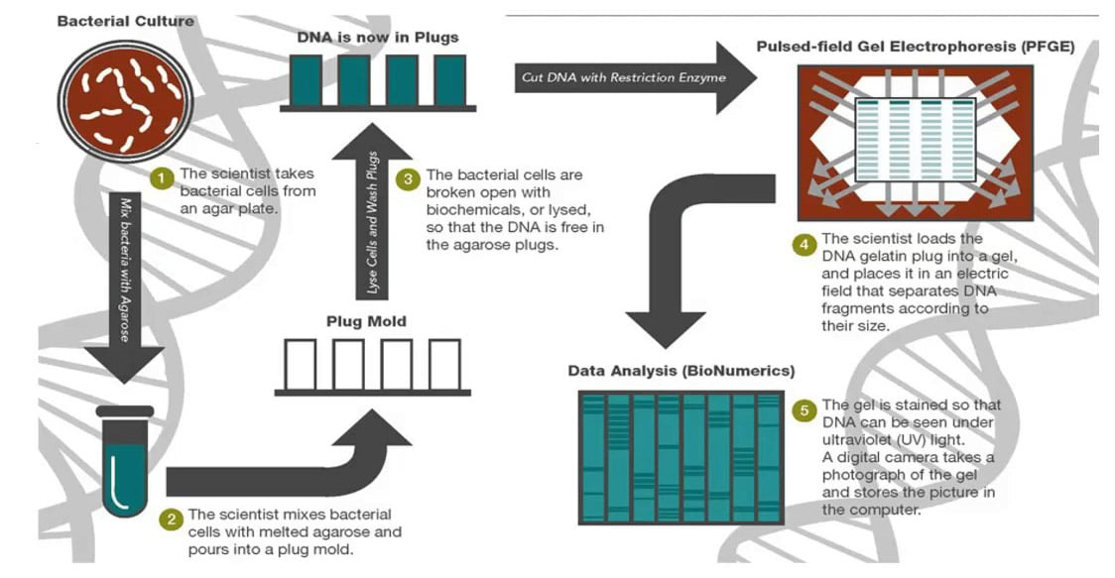
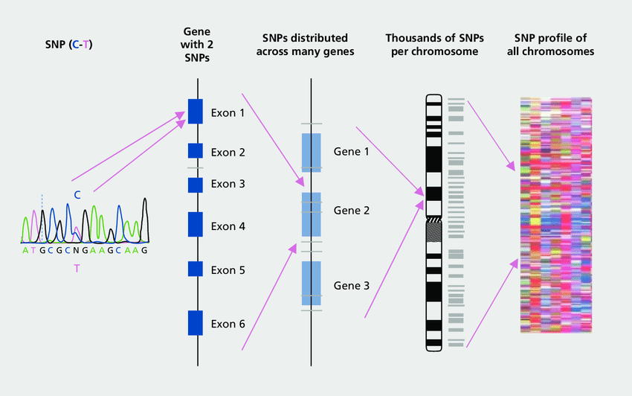
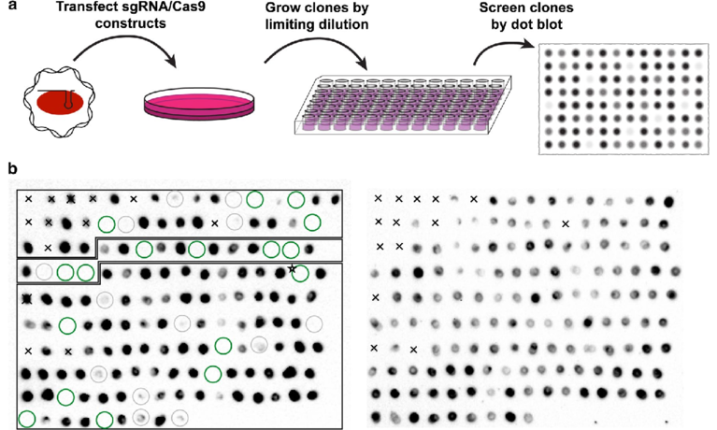
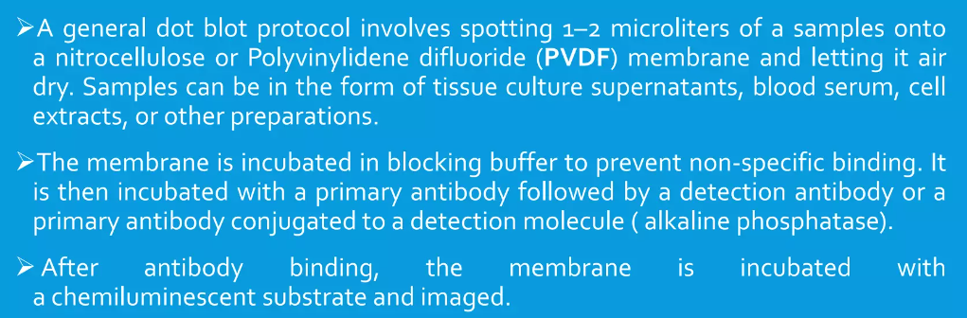
Single nucleotide polymorphisms (SNPs):
Electrophoresis (agarose, pulse filled)
Dot slot blotting
Nucleic acids

Slide 29
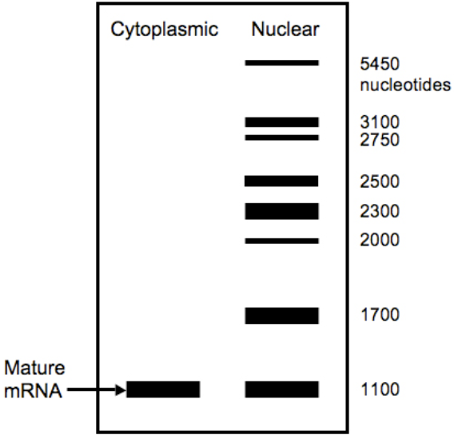
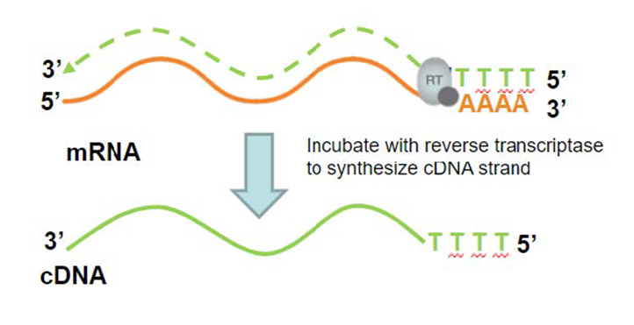
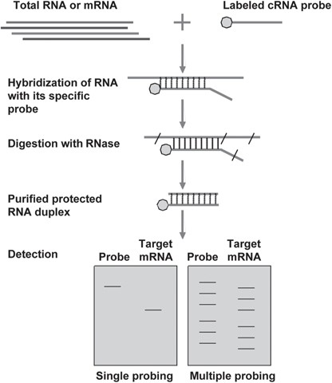
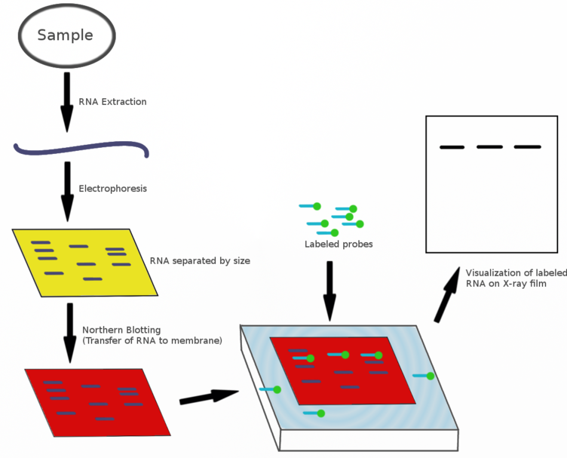
Northern blot
RNAse protection assay
Reverse transcription
Detection and quantification of RNA and DNA sequencing

Slide 30
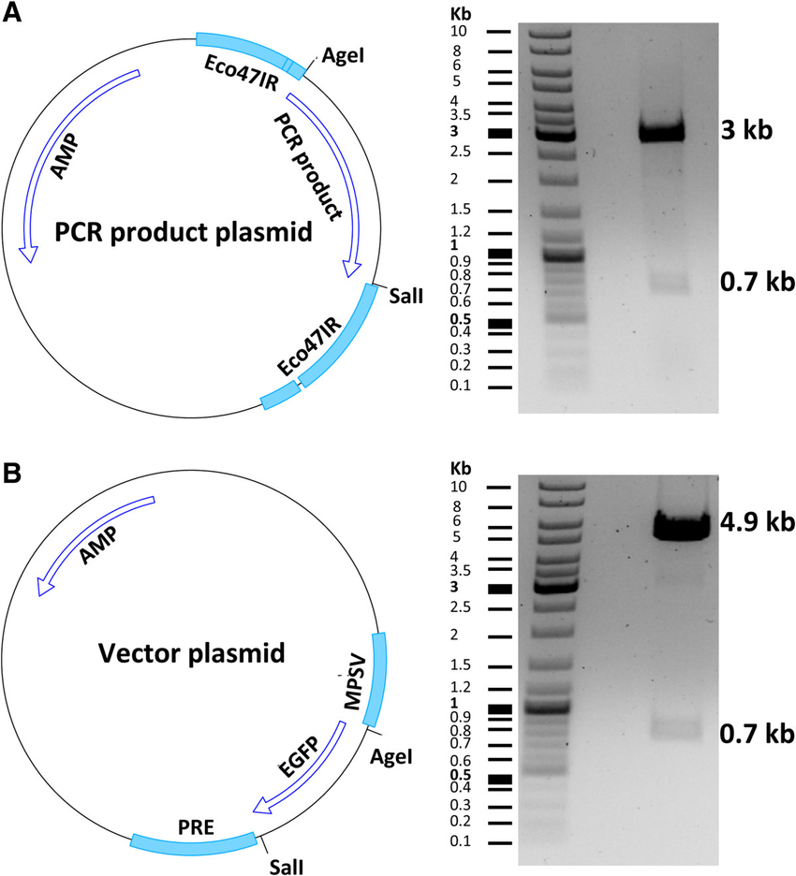
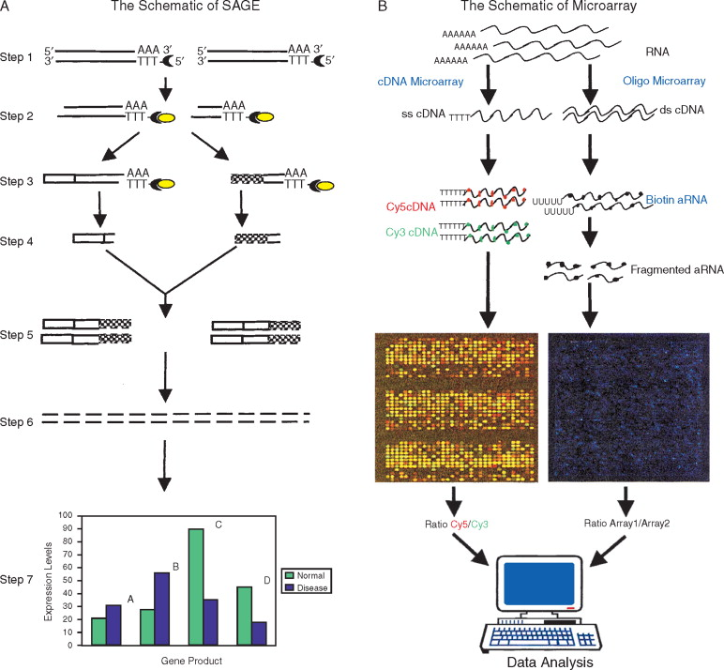
Plasmid and viral vector (PCR and RT-PCR)
SAGE
Cloning and manipulation:
Notes:
Two high-throughput technologies, SAGE (Velculescu et al., 1995) and oligonucleotide (Lockhart et al., 1996) or cDNA microarray (Schena et al., 1995), allow researchers to determine the expression pattern of thousands of genes simultaneously in normal or diseased tissues. With the development of SAGE or DNA microarray-based research, more accurate diagnosis and treatment of various human diseases based on an individual patient's gene expression profile are burgeoning. Two attractive features of SAGE compared with DNA microarray are its ability to quantify gene expression without prior sequence information and its provision of gene expression result in a digital format. The SAGE technique has been intensively applied to the gene expression profiling of a number of human diseases.
Methodology of sage:
l., 2000). The schematic of the SAGE procedure is depicted in Figure 11A. Briefly, poly(A)⁺ RNA is isolated by oligo-dT column chromatography. Then cDNA is synthesized from poly(A)⁺ RNA using a primer of biotin-5′-T₁₈-3′. The cDNA is cleaved with an anchoring enzyme (e.g., NlaIII), and the 3′-terminal cDNA fragments are bound to streptavidin-coated beads. An oligonucleotide linker containing recognition sites for a tagging enzyme (e.g., BsmFI) is linked to the bound cDNA. The tagging enzyme is a class II restriction endonuclease that cleaves the DNA at a constant number of bases 3′ to the recognition site. This results in the release of a short tag plus the linker from the beads after digestion with BsmFI. The 3′-ends of the released tags plus linkers are then blunted and ligated to one another to form 102-bp linked ditags. After polymerase chain reaction (PCR) amplification of the 102-bp ditags, the linkers and tags are release by digestion with the anchoring enzyme. The 26–28 mer tags are then gel purified, concatenated, and cloned into a sequence vector.

Slide 31
Study Design
Methodology
https://doi.org/10.1016/j.ymthe.2018.01.011

Slide 32
2. در یک کارآزمایی بالینی جهت کاهش میزان سکته قلبی به گروهی از افراد قرص ملاتونین توصیه شد. مشاهده شد افزایش ملاتونین در صورت استفاده به صورت روتین و 24ساعته باعث بهبود فاکتورهای دخیل در پایداری پلاک می‌شود. اما استفاده از قرص ملاتونین با این روش سبب خواب‌آلودگی افراد و در نتیجه کاهش عملکرد شغلی آن‌ها شده بود. با هدف کاهش ناپایداری پلاک بدون کاهش عملکرد در این افراد:
الف) بر اساس بخشی از نتایج تحقیق قبلی که نشان میداد تغییر میزان ملاتونین باعث تغییر کاهش تبدیل مونوسیت‌ها به ماکروفاژ و همچنین کاهش فعال‌سازی سلول‌های عضله صاف می‌شود؛ محقق اول پیشنهاد داد که از یک ناقل اختصاصی ملاتونین استفاده کنیم که گیرنده‌آن تنها برروی مونوسیت و سلول‌های عضله صاف عروق باشد.
یک مطالعه in silicoجهت طراحی این ناقل بنویسید.
بهترین‌ مدل invitro برای بررسی صحت عملکرد این ناقل چیست؟
او بر همین اساس ناقل M-SMC را در آزمایشگاه طراحی کرد. مطالعه‌ای طراحی کنید که اثر تجویز ملاتونین متصل به گیرنده M-SM در رسیدن به هدف ذکر شده را بررسی کند.
ب) محقق دوم به این موضوع که ملاتونین از طریق اثر بر گیرنده ملاتونین تایپ1 (MR-1)، باعث کاهش میزان حوادث عروق قلبی ناشی از آترواسکلروز میشود استناد کرد. او پیشنهاد داد به‌جای استفاده از ملاتونین از آگونیست اختصاصی MR-1 استفاده کنیم. مطالعه‌ای طراحی کنید که اثر آگونیست MR-1 در رسیدن به هدف ذکر شده را بررسی کند.
ج) برای مقایسه مطالعات بخش الف-c و ب و انتخاب بهترین روش نتایج حاصل از کدام گروه‌ها را می‌توان بررسی کرد؟ اگر نمیتوانید با نتایج موجود انتخاب کنید، مطالعه طراحی کنید☺

Slide 33


